Slide 1

IRC Measurement
Q & A
International Rating Certificate

Slide 2
STL Definition
The greatest horizontal distance from the forward face of the mast spar, measured on or near the centreline of the boat, to any of the following:
- the extremity of the spinnaker pole, whisker pole or bowsprit;
- the spinnaker tack point on deck projected vertically as necessary;
- if a headsail may be tacked forward of the forestay, the headsail tack point on deck projected vertically as necessary or to the extremity of the bowsprit.

Slide 3
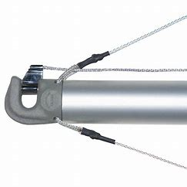
STL – Spinnaker Pole
Extremity of Pole
Pole Measured on CL – Not perpendicular as some other rules.

Slide 4
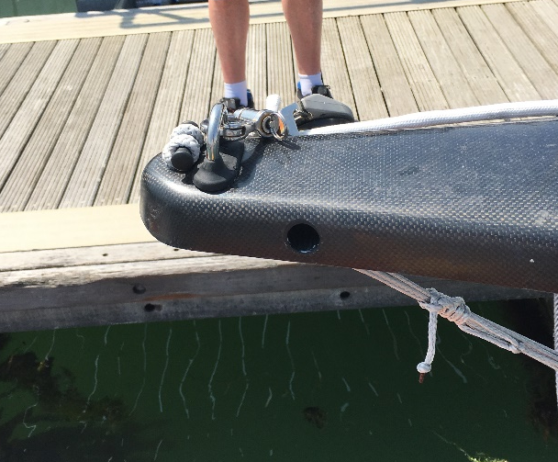
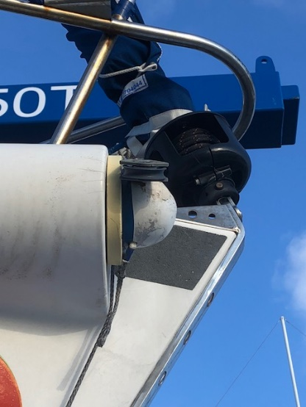
STL – Bowsprit
Remember - Extremity of pole irrespective of attachment point

Slide 5
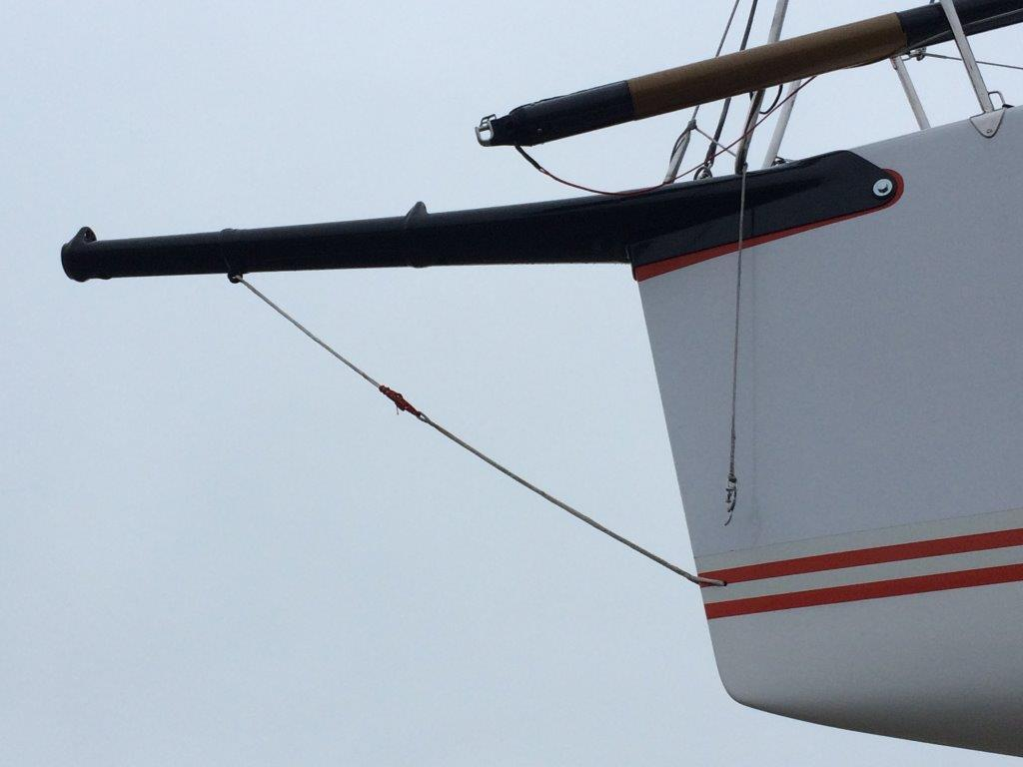
STL – Pole + Bowsprit
STL – Greatest horizontal distance.
However record in the notes both Pole & Bowsprit STL for future reference.

Slide 6
STL on Deck
Notes:
Measure to point B (not A!) with turning block upright

Slide 7
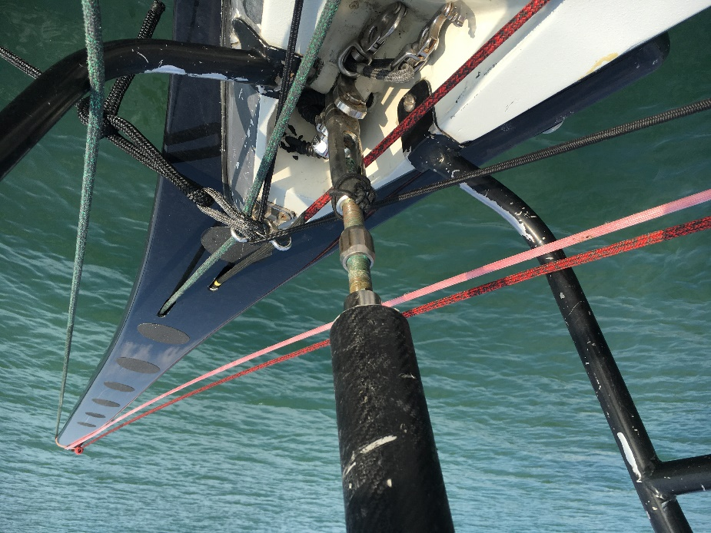
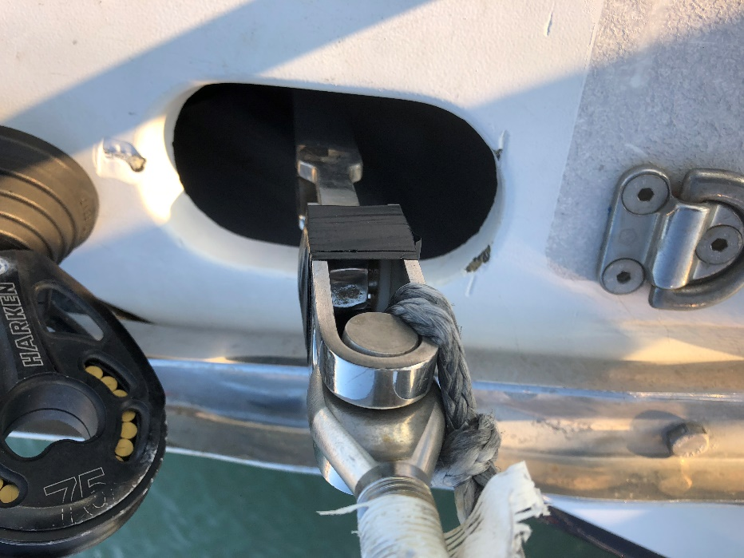
Forward End of J & FL
Notes:
Measure to forestay position at deck level

Slide 8
J - Definition
The longitudinal distance between the intersection of the fore side of the mast spar, extended as necessary, and the deck including any superstructure; and the intersection of the centreline of the forestay, extended as necessary, and the deck, or bowsprit spar.
Note – Forestay Length refers to the forward end of J

Slide 9
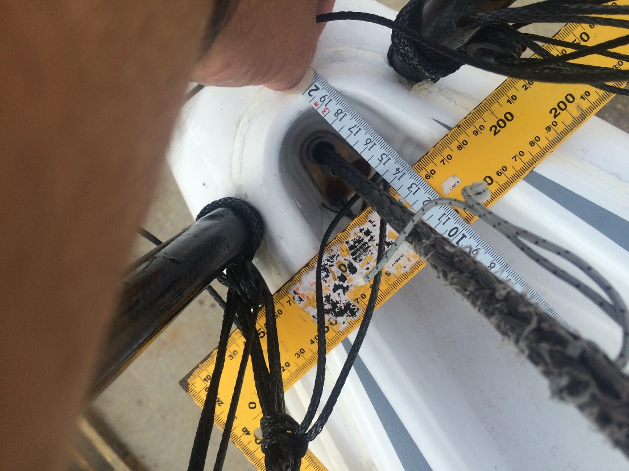
Intersection of Forestay & Deck

Slide 10
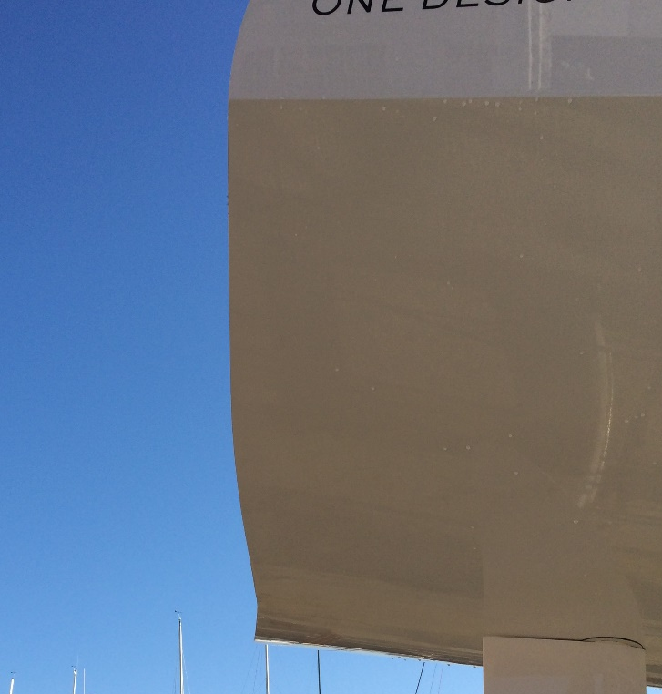
Stern Cut Away
LH & SO
Watch out LH point on Hull may not be on centreline!
Always check LH to aft quarters if in doubt

Slide 11
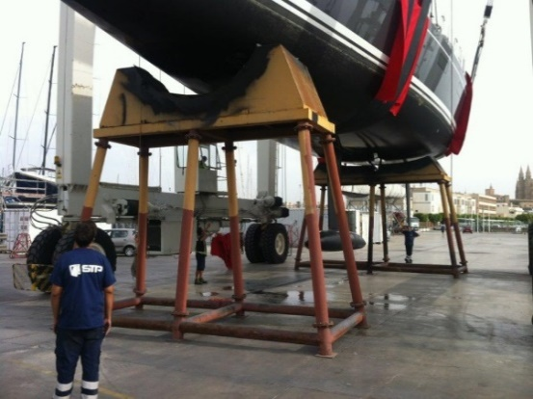
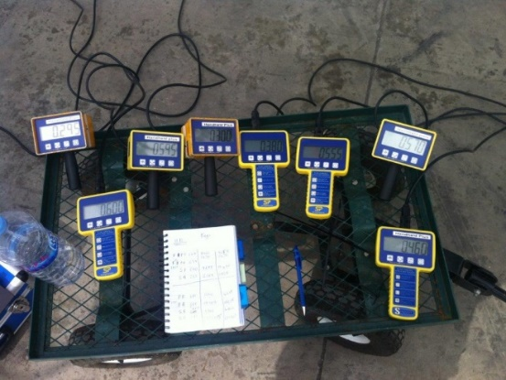
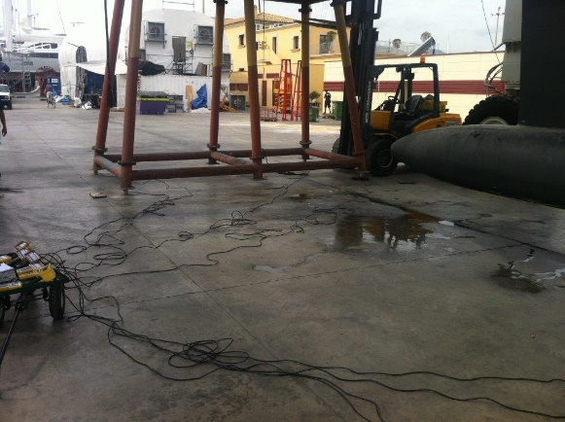
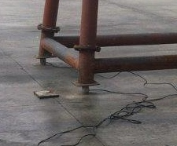
Weighing – Compression Loadcells
Only for boats that due to weight or hull shape can’t be weighed by single point lift.

Slide 12
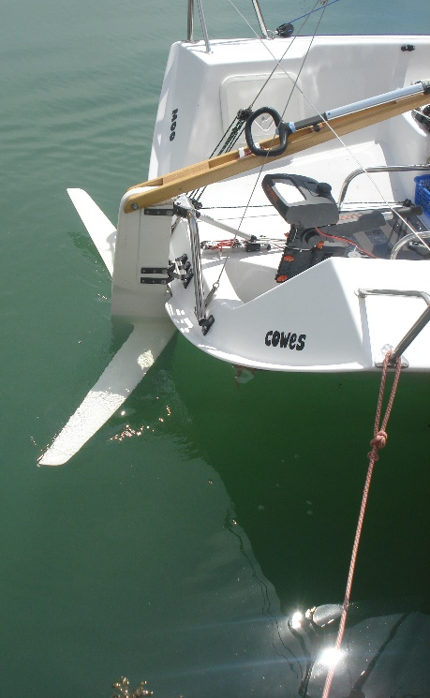
Extra Things To Report
In addition to the information requested on the measurers input form – Look out and note where possible:
Rig Material + Spreaders
Aft Rigging
Adjustable Forestay and/or Mast Foot
Powered Winches
Powered Backstays
Prop Configuration
Anything that looks unusual
Take Pictures
Take Some More Pictures

Slide 13
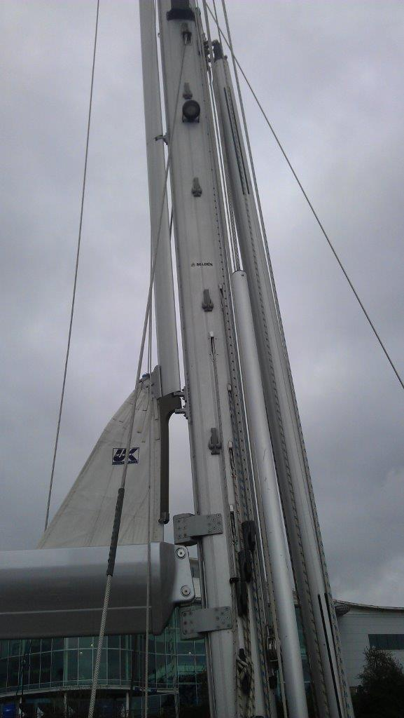
Not Sure??
Not sure on reference for
measurement?
Measurer alternative options;
Take pictures / sketch options;
Leave it to the Rating Office to
decide!

Slide 14
Equipment Inspection
What you can check based on against the IRC Certificate
Notes:
Engine – If outboard check it’s on the boat and weight looks correct
Internal Ballast – Is it fitted if listed
Batteries & cushions
Lifelines
Powered winches
Canting Keel or Water Ballast
Forestay & Mast Heel Movement – If means to adjust but declared and not adjusted whilst racing discuss with owner how they make sure it does not get adjusted accidentally!
If Single Furling or Single Furling + HWJ – Check this is what is fitted
Number of Spinnakers – Reference NOR to see if sails can be changed between race days
Check pole type matches
Look up at rig, is the material, rigging & spreader sweep correct
Is the Aft Rigging Correct

Slide 15
Equipment Inspection
Notes:
Check E & P bands in place
E easy to do a quick measurement check – P a bit harder, in events such as Commodores Cup teams advised that someone may need to go up the rig
STL – Check from rig of check STL – J for a quick check on a bowsprit

Slide 16
Equipment Inspection

Slide 17
Measurement Tools
<<get measurers to show and tell any measurement tools here for example:
Freeboard Tubes
45 degree spirit level for bow overhang >>

Slide 18
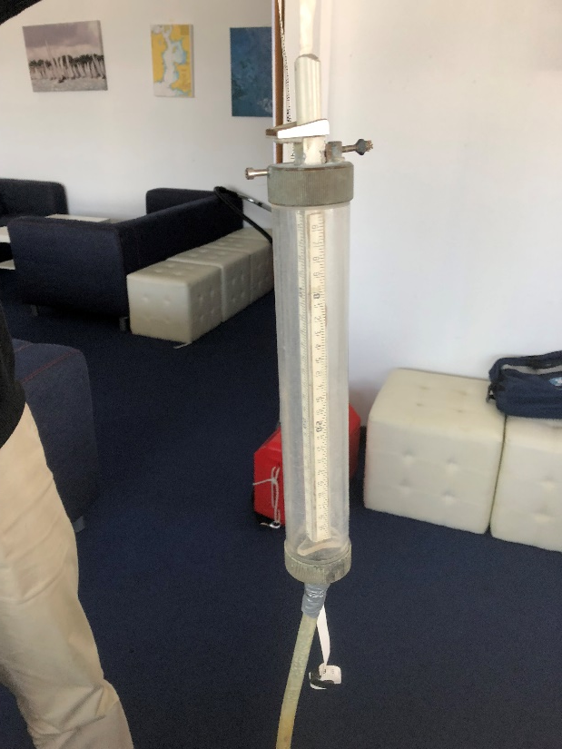
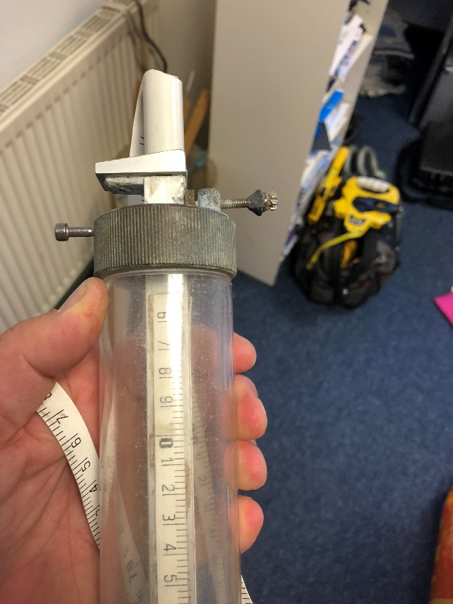
Freeboard Tube

Slide 19
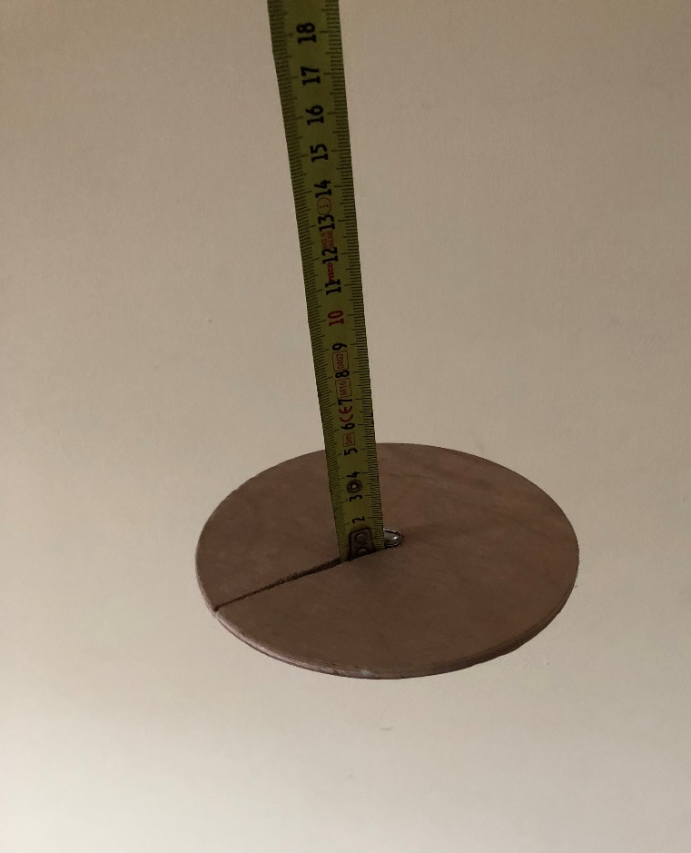
Freeboard Disk
Notes:
Floats on WL as gives a clearer starting point
Measurements need to be corrected based on immersion of disk – Typically (-5mm)

Slide 20
The End

Slide 21
E - Definition
The outer point distance of a mainsail (or in the case of a schooner, a foremast sail). The outer limit mark shall be permanently marked by a 25mm band of contrasting colour. If there is no band the measurement shall be taken to the aft end of the boom. For the measurement of outer point distance, ERS H.4.2 shall not apply. Fittings, local curvature, local cutaway and any increase in the fore/aft dimension of a sail track and/or sail track support, shall be ignored.
Notes:
Optional presentation about E measurement

Slide 22
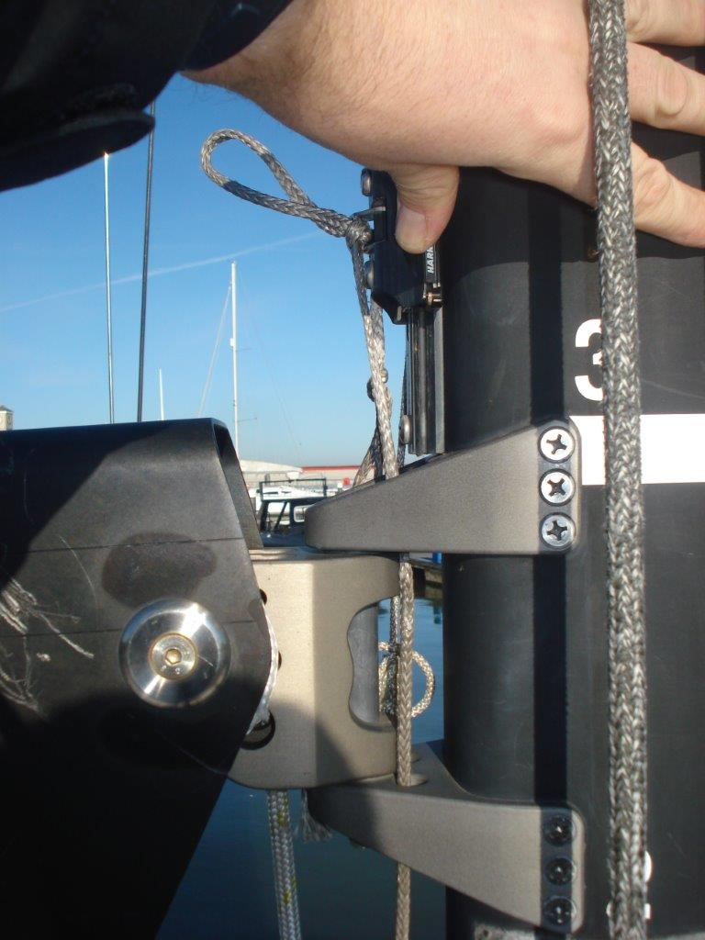
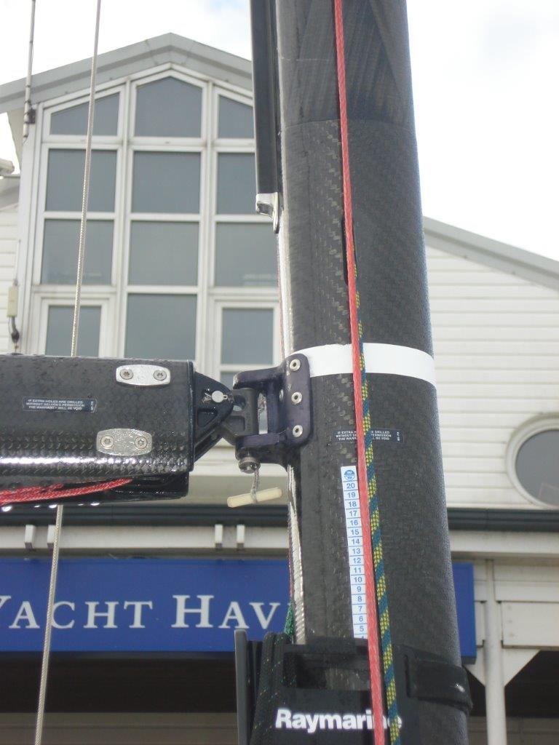
E Measurement @ Spar

